Slide 1

HR Data Analysis
Insights and Findings
Photo by Pexels

Slide 2
Table of Contents
01
Introduction
02
Headcount by Job Role
03
Gender Distribution
04
Salary Discrepancies
05
Highest Earners
06
Qualifications vs. Salaries
07
Leave Balances
08
HR Dashboard
09
Conclusion

Slide 3

1
Introduction
Project Overview
The HR Data Analysis project is aimed at leveraging data-driven insights to optimize human resources management within our organization.
By analyzing comprehensive datasets, we seek to gain valuable insights into various facets of our workforce dynamics.
Photo by Pexels

Slide 4
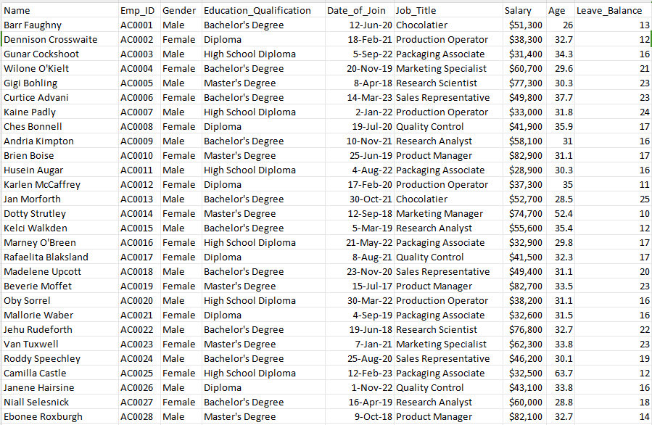
The Data
Photo by Pexels

Slide 5
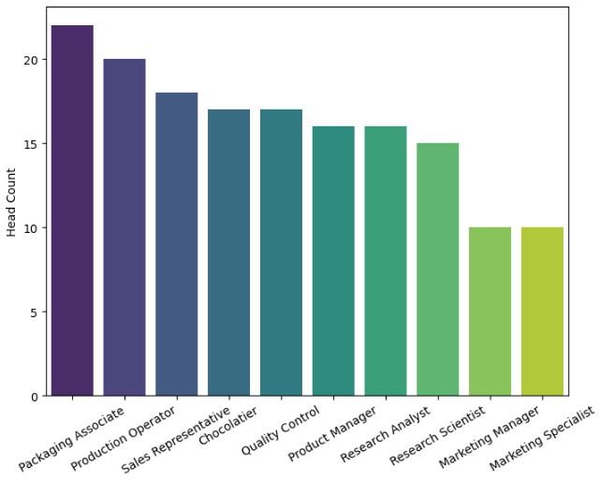
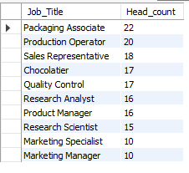
2
SQL Query:
select Job_Title, count(Job_Title) as Head_count from hr_data_analysis group by Job_Title;
Headcount by Job Role
Job Role Headcount

Slide 6
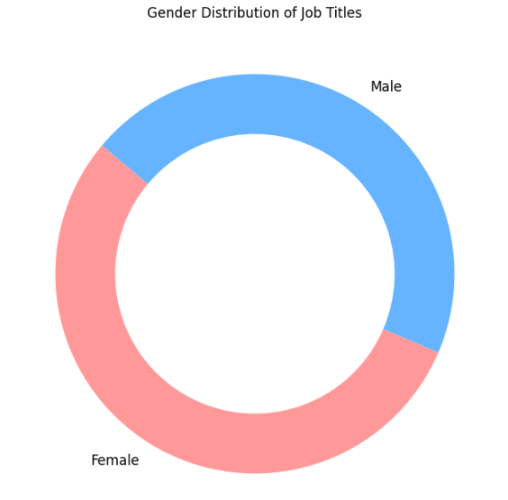
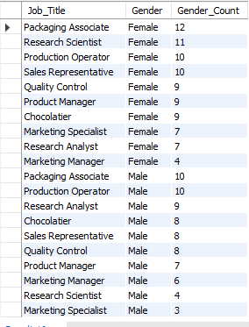
3
SQL Query:
select Job_Title, Gender, count(Gender) as Gender_Count from hr_data_analysis group by Job_Title, Gender order by Gender, Gender_Count desc;
Gender Distribution
Staff Gender Distribution

Slide 7
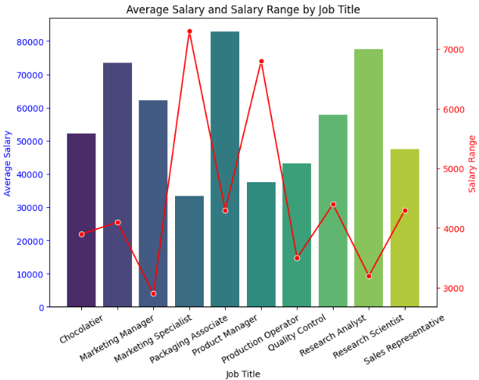
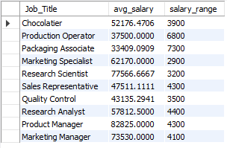
SQL Query:
select Job_Title, avg(Salary_digit) as avg_salary, max(Salary_digit) - min(Salary_digit) as salary_range from hr_data_analysis group by Job_Title;
4
Salary Discrepancies
Salary Discrepancies

Slide 8
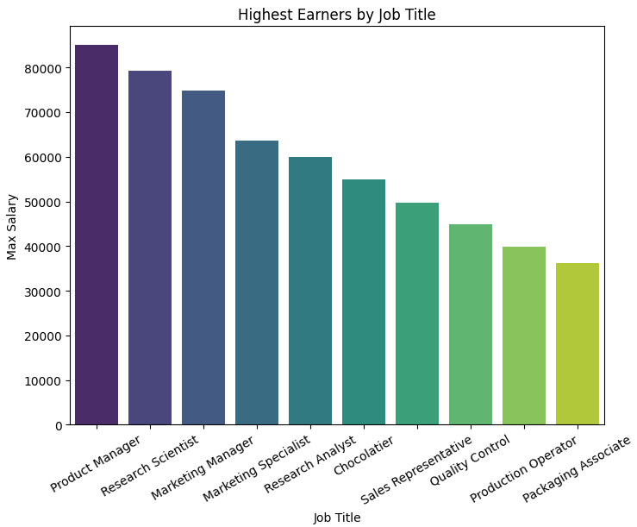
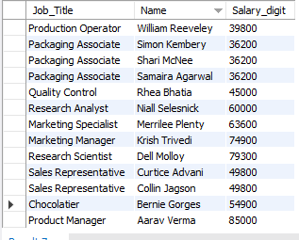
5
SQL Query:
select hr.Job_Title, hr.Name, hr.Salary_digit from hr_data_analysis hr
where
hr.Salary_digit = (select max(Salary_digit) from hr_data_analysis where Job_Title = hr.Job_Title) order by hr.Job_Title;
Highest Earners
Top Earners by Role

Slide 9
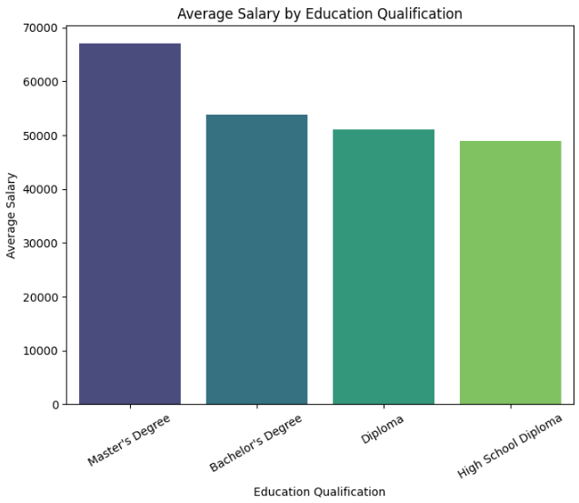
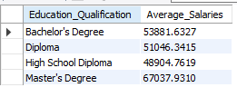
6
SQL Query:
select Education_Qualification, avg(Salary_digit) as Average_Salaries from hr_data_analysis group by Education_Qualification;
Qualifications vs. Salaries
Qualifications Impacting Salaries

Slide 10
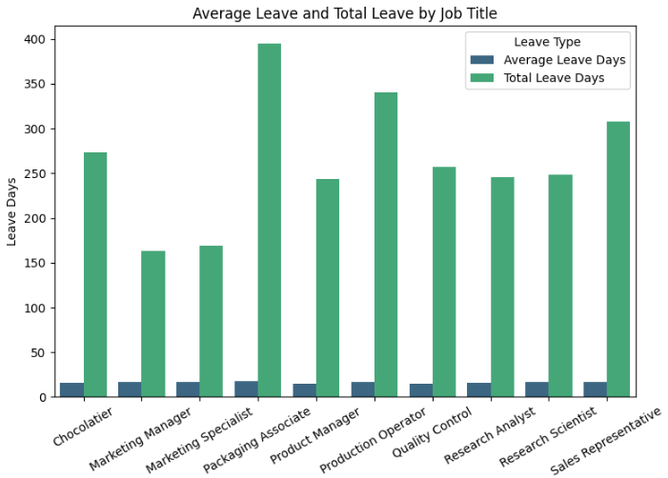
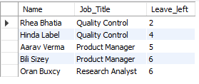
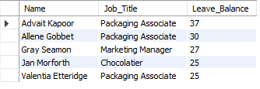
SQL Query:
select Name, Job_Title, Leave_Balance from hr_data_analysis order by Leave_Balance desc limit 5;
select Name, Job_Title, Leave_Balance from hr_data_analysis order by Leave_Balance asc limit 5;
7
Leave Balances
Analysis of Leave Balances

Slide 11
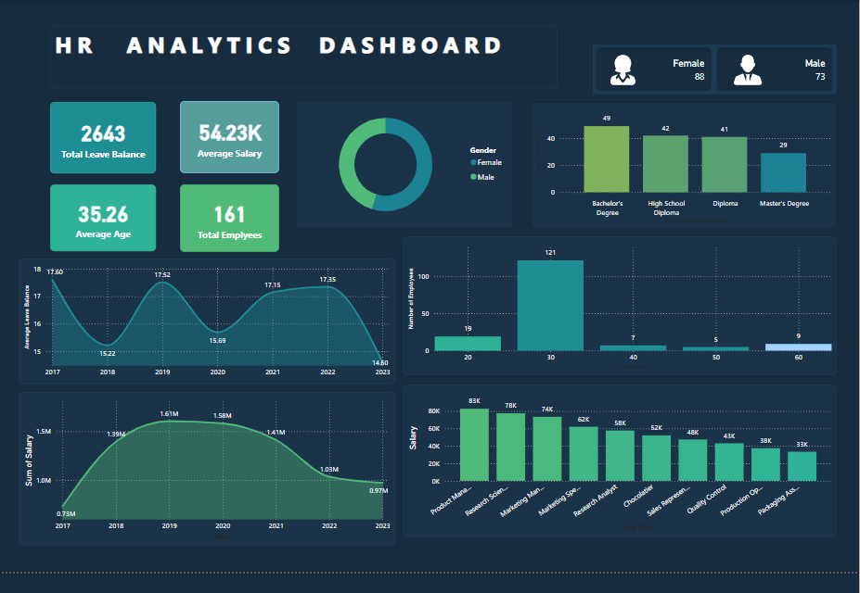
8
HR Dashboard

Slide 12

9
Conclusion
Key Findings & Recommendations
The largest group of employees holds a Bachelor's Degree (49 employees).
The 20-30 age group is the most represented, with 121 employees.
The total salary peaked at 1.6M in both 2019 and 2020 but has declined to 0.97M by 2023.
Product Managers, Research Scientists, and Marketing Managers are among the highest-paid roles, with salaries ranging from 74K to 83K.
Employees with a Master's Degree are fewer, totaling 29.
Photo by Pexels

